Slide 1

RSA CRYPTOGRAPHY
What is cryptography?
RSA
RSA Setup - Algorithm
Why does it work?
Hardness of RSA
Attacks to RSA
Future – Quantum Computers
RSA CRYPTOGRAPHY
Prepared by Elif Cemre Durgut

Slide 2

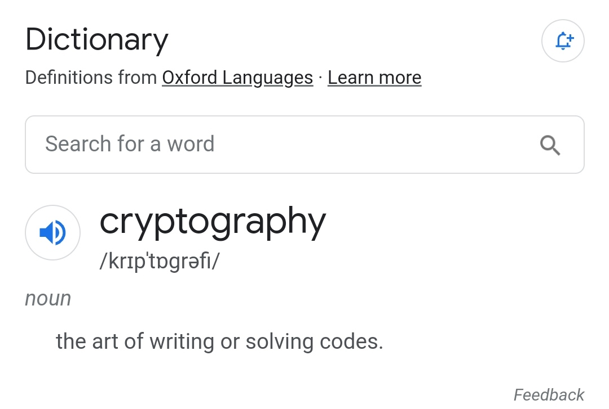
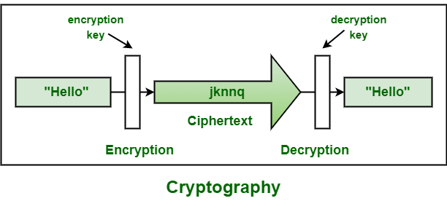
RSA CRYPTOGRAPHY
What is cryptography?
RSA
RSA Setup - Algorithm
Why does it work?
Hardness of RSA
Attacks to RSA
Future – Quantum Computers
Secure communication techniques using mathematical algorithms

Slide 3
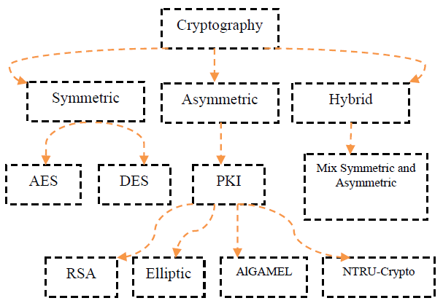
RSA CRYPTOGRAPHY
What is cryptography?
RSA
RSA Setup - Algorithm
Why does it work?
Hardness of RSA
Attacks to RSA
Future – Quantum Computers

Slide 4
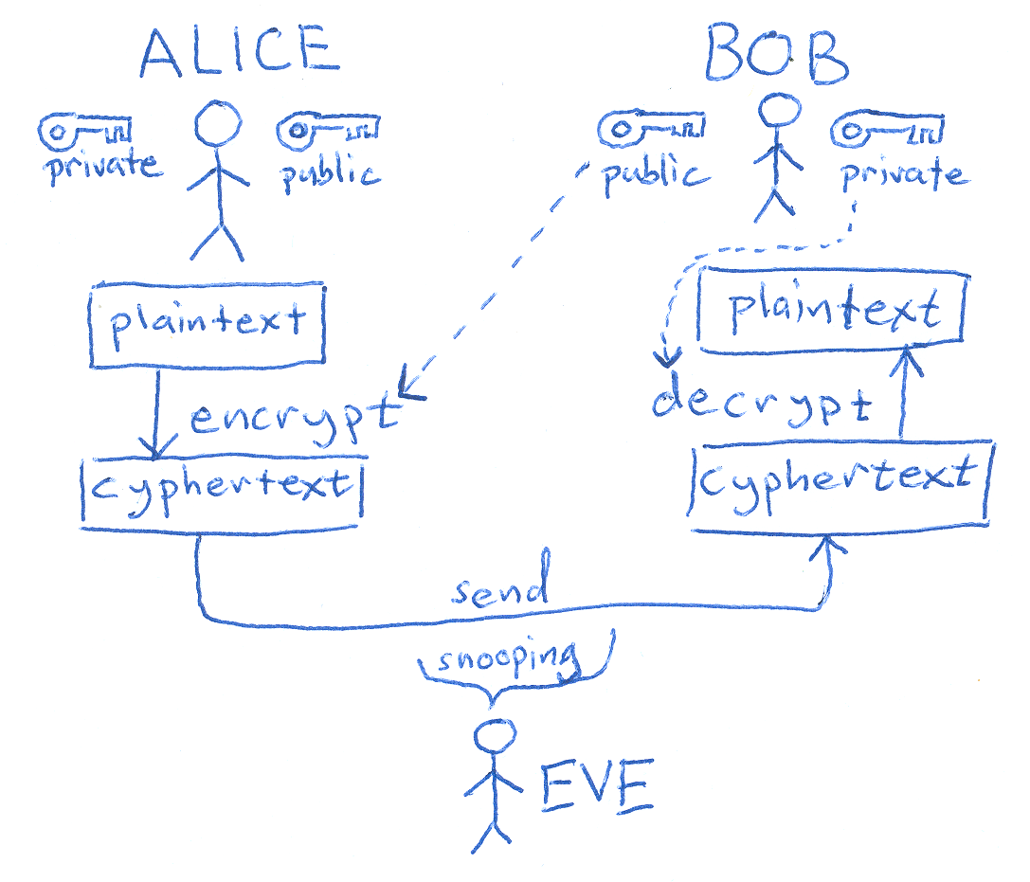
RSA CRYPTOGRAPHY
What is cryptography?
RSA
RSA Setup - Algorithm
Why does it work?
Hardness of RSA
Attacks to RSA
Future – Quantum Computers

Slide 5
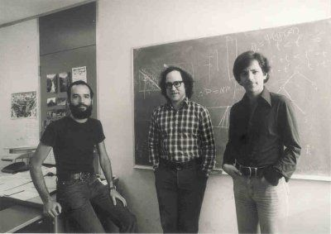
RSA CRYPTOGRAPHY
What is cryptography?
RSA
RSA Setup - Algorithm
Why does it work?
Hardness of RSA
Attacks to RSA
Future – Quantum Computers
Rivest
Shamir
Adleman
~ one of the most popular public key cryptosystems
~ Introduced by Rivest, Shamir and Adleman in 1977 at MIT
~ RSA patent expired in 2000 → can be used for commercial and non-commercial use for free
~ Based on Integer Factorization problem
~ Each user has public and private key pair

Slide 6
RSA CRYPTOGRAPHY
What is cryptography?
RSA
RSA Setup - Algorithm
Why does it work?
Hardness of RSA
Attacks to RSA
Future – Quantum Computers
How does RSA work?
1) Choose two large prime numbers p and q (2048 bit)
2) Compute n = p×q
3) Compute Φ(n) = (p-1)(q-1)
4) Choose a random integer, 0 < e < Φ(n) with gcd(e, Φ(n)) = 1
5) Compute the inverse d = e⁻¹ mod Φ(n),
i.e. e ⋅ d ≡ 1 mod Φ(n)
(Note: This will help us in the proof!)
Public keys: e, n
Private keys: p, q and d

Slide 7
RSA CRYPTOGRAPHY
What is cryptography?
RSA
RSA Setup - Algorithm
Why does it work?
Hardness of RSA
Attacks to RSA
Future – Quantum Computers
Encryption is done using the receiver’s public key:
y ≡ x^{e} mod n, where x < n
Decryption is done using the receiver’s private key:
x ≡ y^{d} mod n

Slide 8
RSA CRYPTOGRAPHY
What is cryptography?
RSA
RSA Setup - Algorithm
Why does it work?
Hardness of RSA
Attacks to RSA
Future – Quantum Computers
EXAMPLE
If Alice wants to send a message to Bob, she needs Bob’s public key
ALICE | BOB
 | Chooses p = 3 and q = 11
 | N = p ∙ q = 33
 | Φ(n) = (p-1)(q-1) = 20
 | Chooses e = 3
 | d = e⁻¹ mod Φ(n) = 7
 | Sends (e, n) to Alice.
Message x = 4
Encrypts y ≡ x^{e} mod n = 31
Sends y to Bob.
 | Decrypts x ≡ y^{d} mod n = 4

Slide 9
RSA CRYPTOGRAPHY
What is cryptography?
RSA
RSA Setup - Algorithm
Why does it work?
Hardness of RSA
Attacks to RSA
Future – Quantum Computers
WHY DOES RSA WORK?
E → y ≡ x^{e} mod n
D → x ≡ y^{d} mod n
We want to prove y^{d} mod n ≡ x
y^{d} mod n ≡ (x^{e} mod n)^{d} mod n
≡ x^{ed} mod n
e⋅d ≡ 1 mod Φ(n) → e⋅d = 1 + k⋅ Φ(n) (k: non-negative integer)
x^{ed} mod n ≡ x^{1 + kΦ(n)} mod n
≡ x¹ ⋅ x^{kΦ(n)} mod n
If gcd(x, n) = 1 , the proof ends here.
Euler’s Theorem
gcd(x, n) = 1 → x^{Φ(n)} ≡ 1 mod n

Slide 10
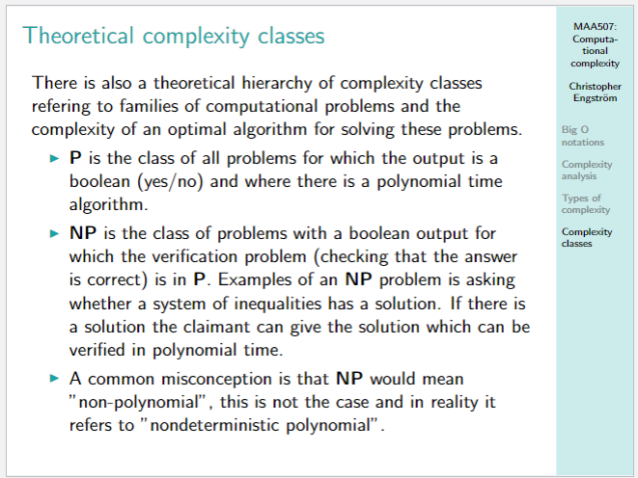
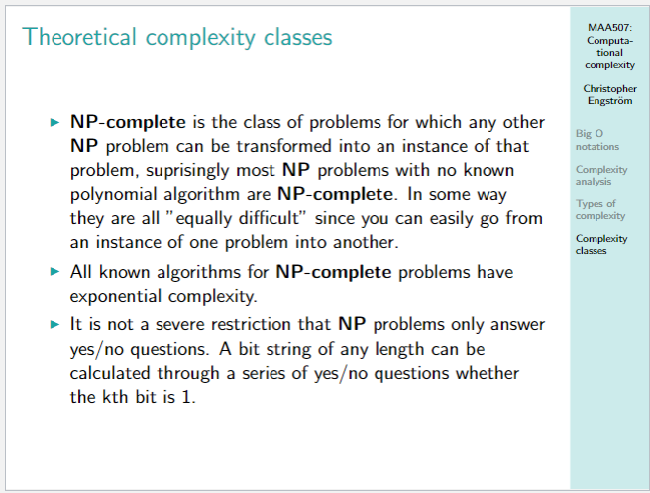
RSA CRYPTOGRAPHY
What is cryptography?
RSA
RSA Setup - Algorithm
Why does it work?
Hardness of RSA
Attacks to RSA
Future – Quantum Computers
Why is it hard to break RSA?
~ RSA depends on the hardness of the integer factorization problem.
~ Integer factorization is in NP but not NP-complete.
~ There are no efficient known factoring algorithms for large integers.
~ Largest integer factored so far is 829-bit.
~ The best is General Number Field Sieve which has sub-exponential complexity

Slide 11
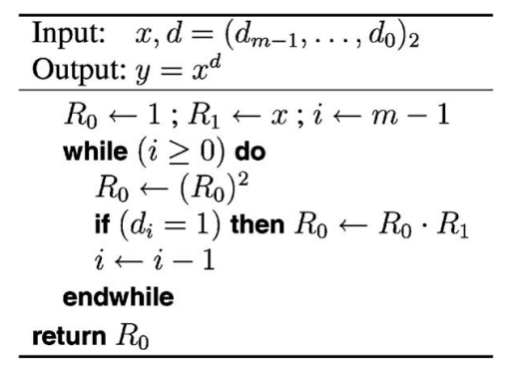
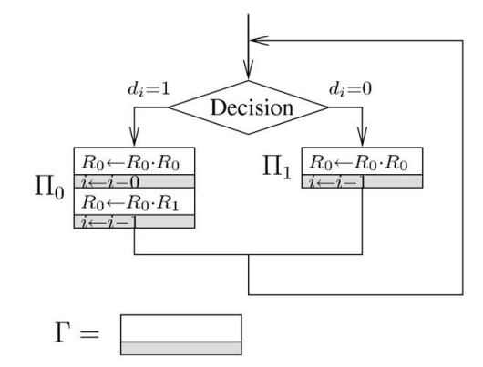
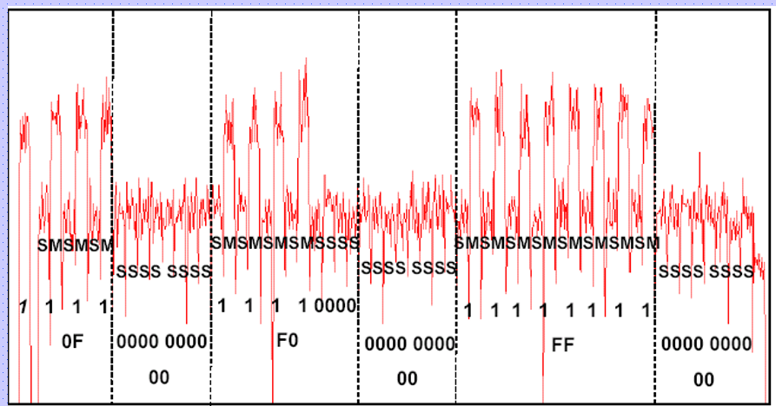
RSA CRYPTOGRAPHY
What is cryptography?
RSA
RSA Setup - Algorithm
Why does it work?
Hardness of RSA
Attacks to RSA
Future – Quantum Computers
Mathematical Attacks
Factoring N
Side Channel Attacks
Simple P. A.
Differential P. A.
Timing Attacks

Slide 12
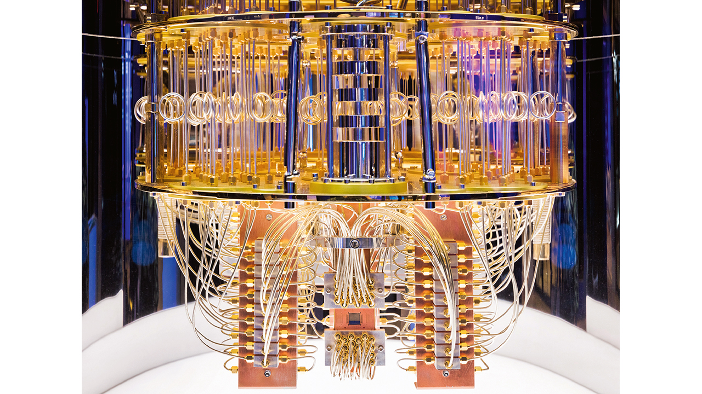
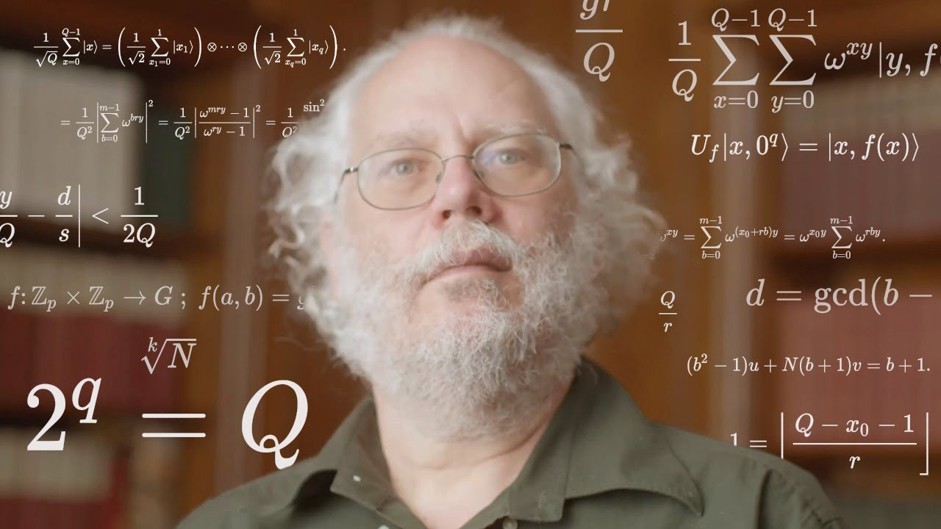
RSA CRYPTOGRAPHY
What is cryptography?
RSA
RSA Setup - Algorithm
Why does it work?
Hardness of RSA
Attacks to RSA
Future – Quantum Computers
What about Quantum computers?
~Shor’s Algorithm in 1994 by Peter Shor
~Integer factorization can be done in polynomial time using quantum computers
~The largest integer factored is 21?

Slide 13
RSA CRYPTOGRAPHY
What is cryptography?
RSA
RSA Setup - Algorithm
Why does it work?
Hardness of RSA
Attacks to RSA
Future – Quantum Computers
?

Slide 14
REFERENCES
Bellare, M., Rogaway, P. (1995). Optimal Asymmetric Encryption How to Encrypt with RSA. https://cseweb.ucsd.edu/~mihir/papers/oaep.pdf
Bernstein, D. J., Heninger, N., Lou, P., Valenta, L. (2017). Post-quantum RSA. https://cr.yp.to/papers/pqrsa-20170419.pdf
Chevallier-Mames, B., Ciet, M., Joye, M. (2004). Low-Cost Solutions for Preventing Simple Side-Channel Analysis: Side-Channel Atomicity. IEEE Transactions on Computers, Vol. 53, No. 6. https://citeseerx.ist.psu.edu/viewdoc/download?doi=10.1.1.457.2254&rep=rep1&type=pdf
Courrege, J., Feix, B., Rousselet, M. (2010). Simple Power Analysis on Exponentiation Revisited. IFIP International Federation for Information Processing. https://link.springer.com/content/pdf/10.1007%2F978-3-642-12510-2_6.pdf
Kocher, P. (1996). Timing Attacks on Implementations of Diffie-Hellman, RSA, DSS, and Other Systems. https://paulkocher.com/doc/TimingAttacks.pdf
Kocher, P., Jaffe, J., Jun, B. (1994). Differential Power Analysis. https://www.paulkocher.com/doc/DifferentialPowerAnalysis.pdf
Rivest, R. L., Shamir, A., Adleman, L. (1977). A Method for Obtaining Digital Signatures and Public-Key Cryptosystems. https://people.csail.mit.edu/rivest/Rsapaper.pdf
Zhou, Y., Feng, D. (2005). Side-Channel Attacks: Ten Years After Its Publication and the Impacts on Cryptographic Module Security Testing. National Natural Science Foundation of P.R. China. https://csrc.nist.gov/csrc/media/events/physical-security-testing-workshop/documents/papers/physecpaper19.pdf

